Slide 1
Washington State Fatal Crash Analysis
Team 23028: Zizheng Zhang, Xiaoze Liu, Wangxi Pan

Slide 2

Data Source
The Washington Coded Fatal Crash (CFC) Data from WTSC and their traffic safety partners .
Data includes:
Location
Traffic Condition
Driver Information
Accident Information

Slide 3
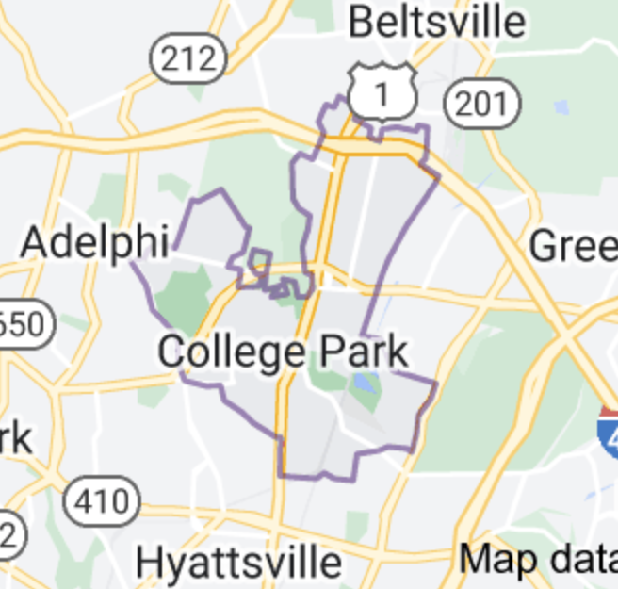
Data Process
Reverse geocoding
20781
Notes:
Add x,y into graph

Slide 4
Data Process
Drive Off Road
Control/Traction Loss
Avoid Collision with Vehicle, Pedestrian, Animal
Parked Vehicle
Other (Single Driver)
Crash Type Category:
Single Driver

Slide 5
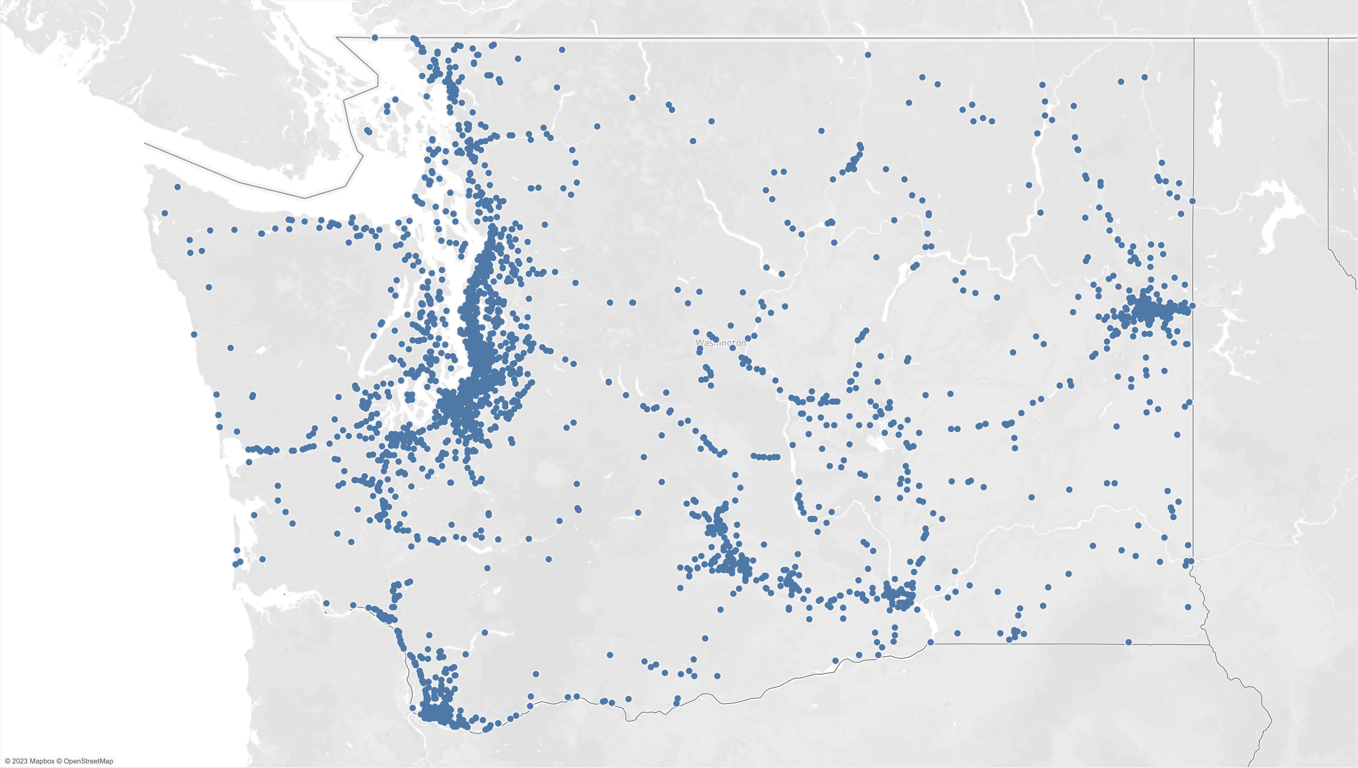
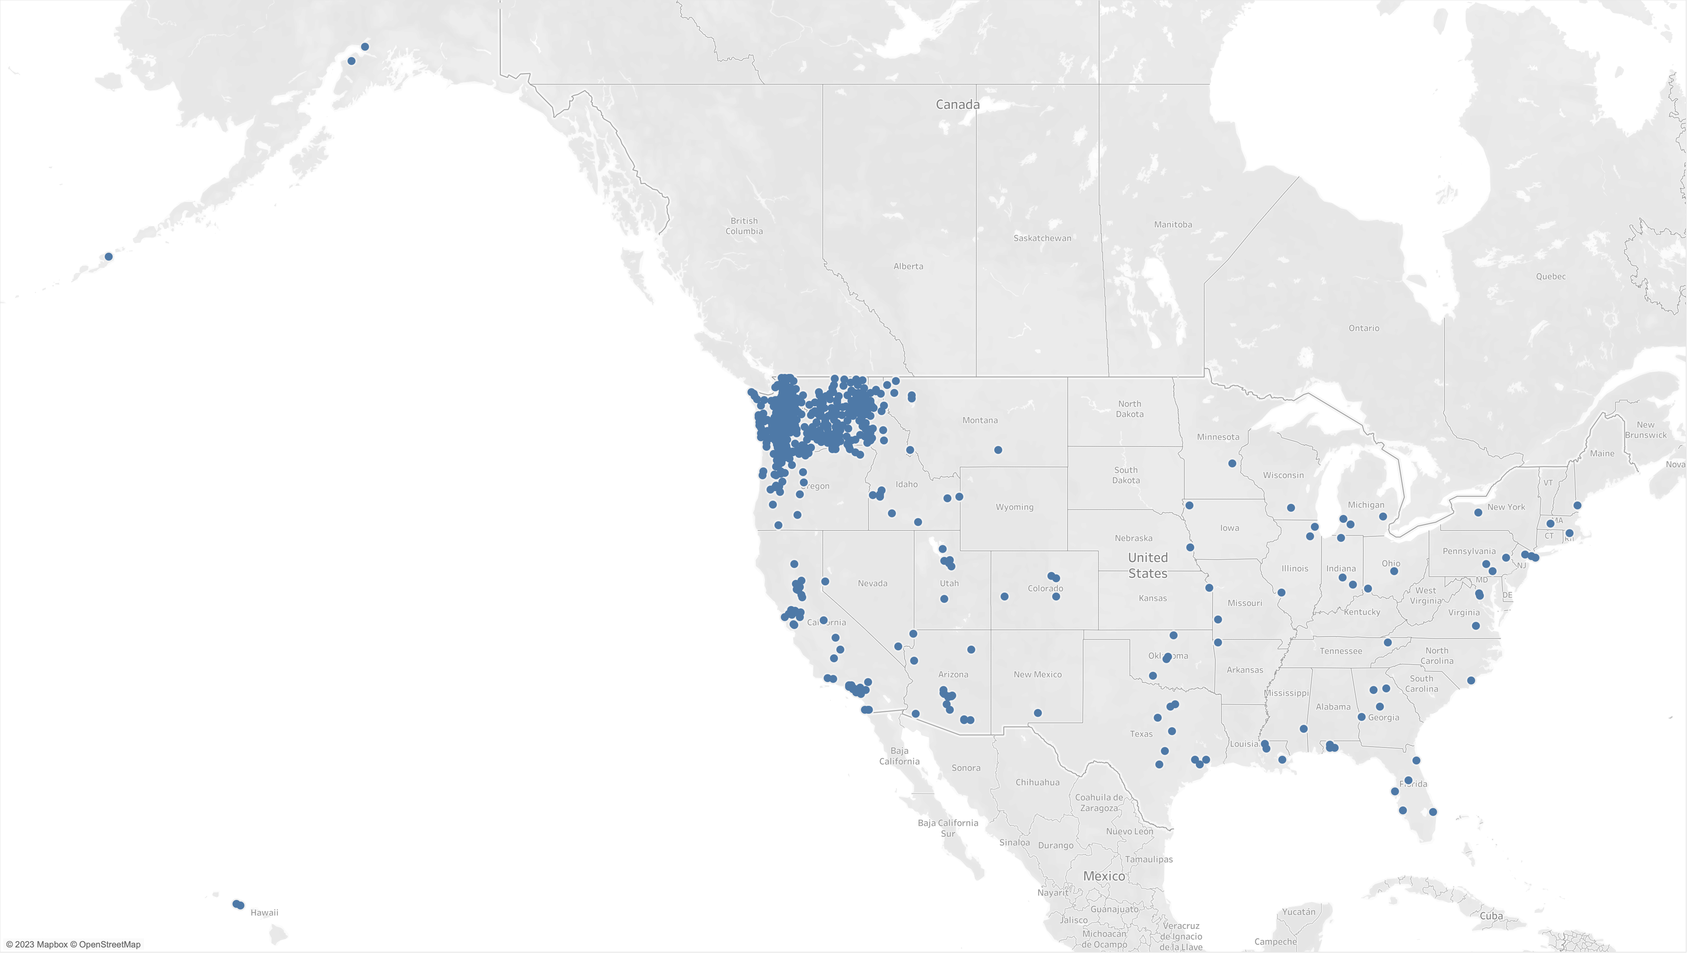
Accidents
Drivers’ Addresses
vs.

Slide 6
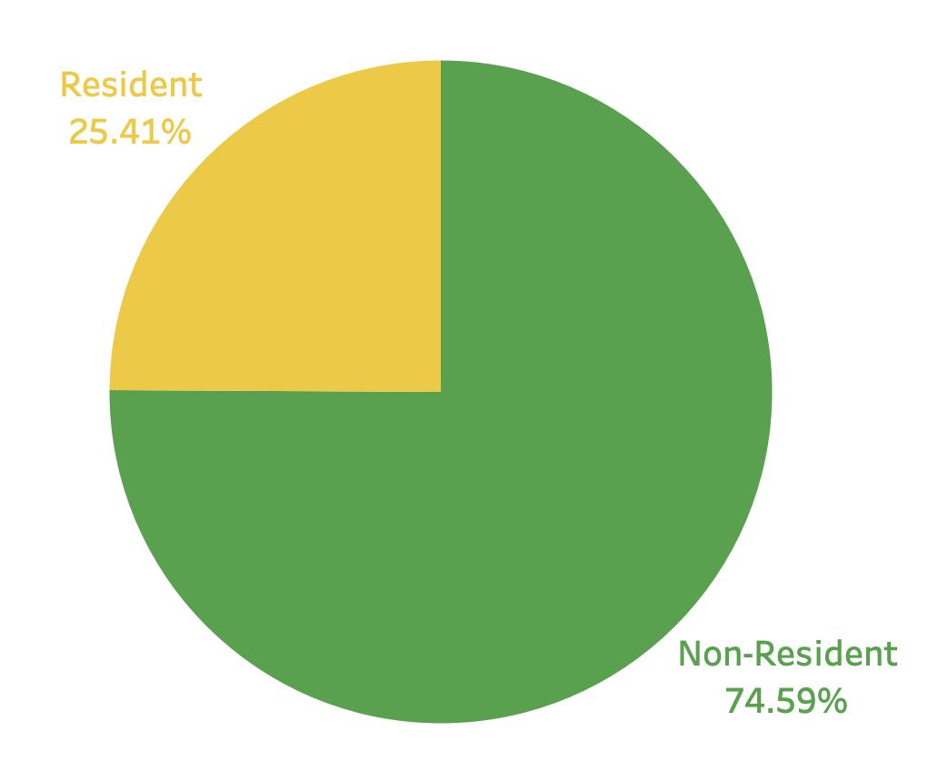
Question
Non-resident drivers shows a much higher percentage in fatal accidents.
WHY?

Slide 7
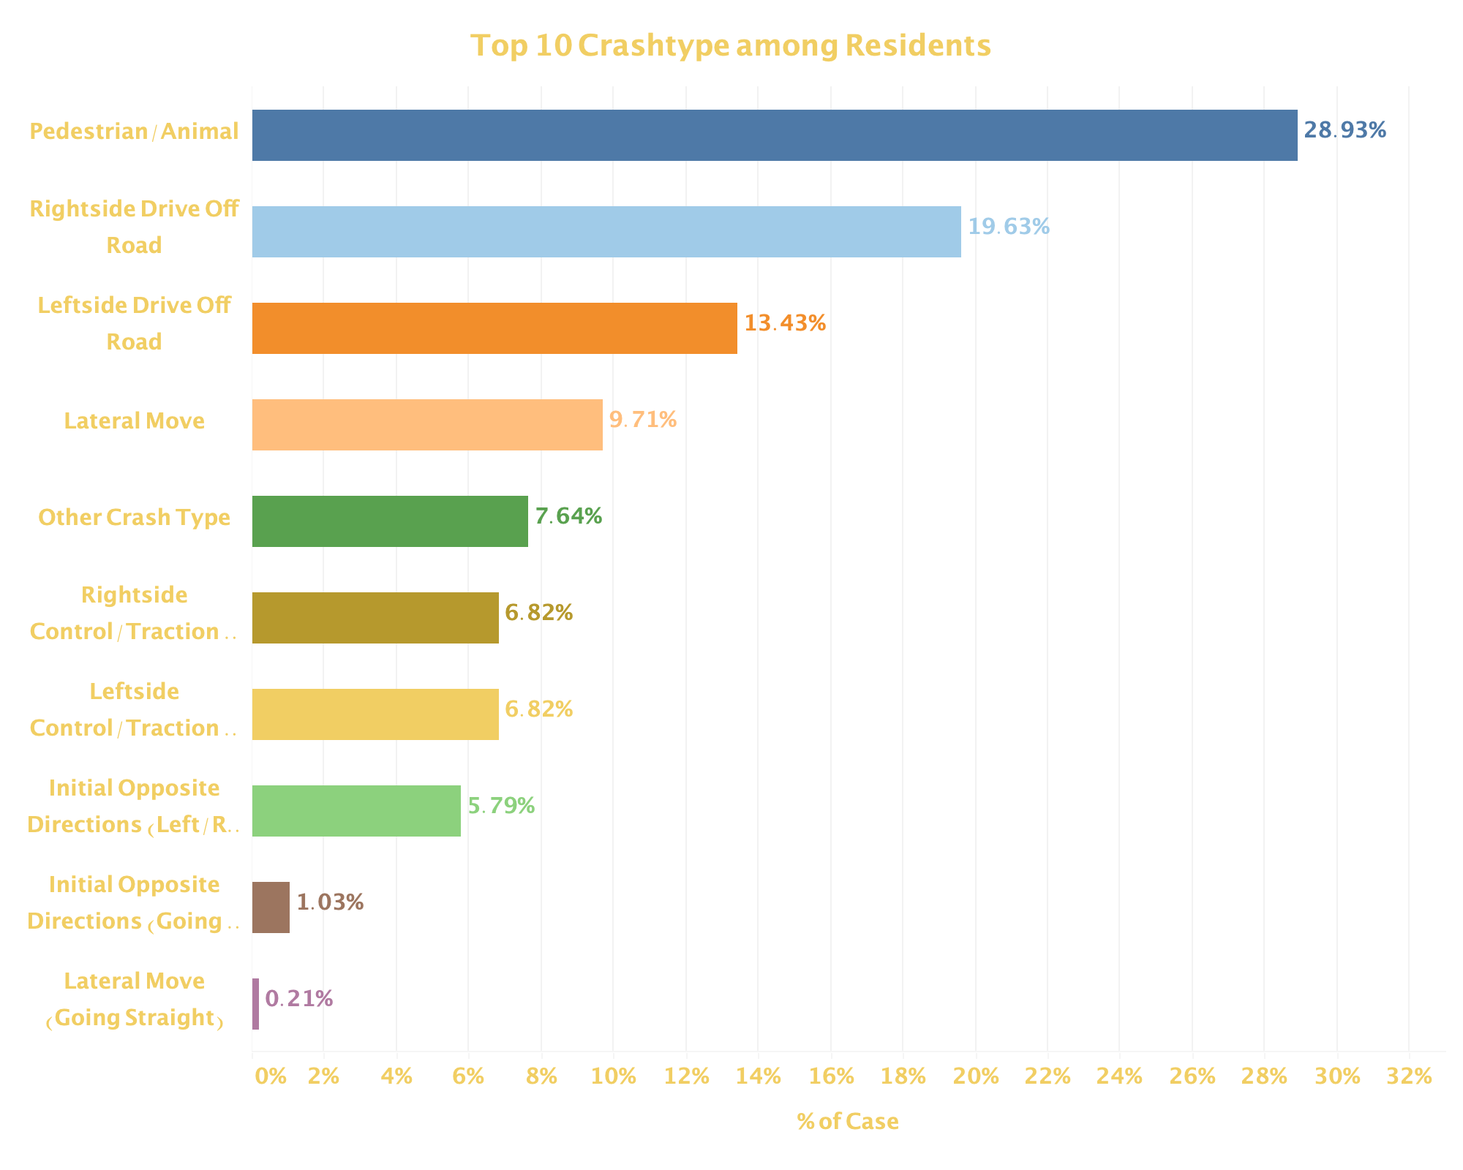
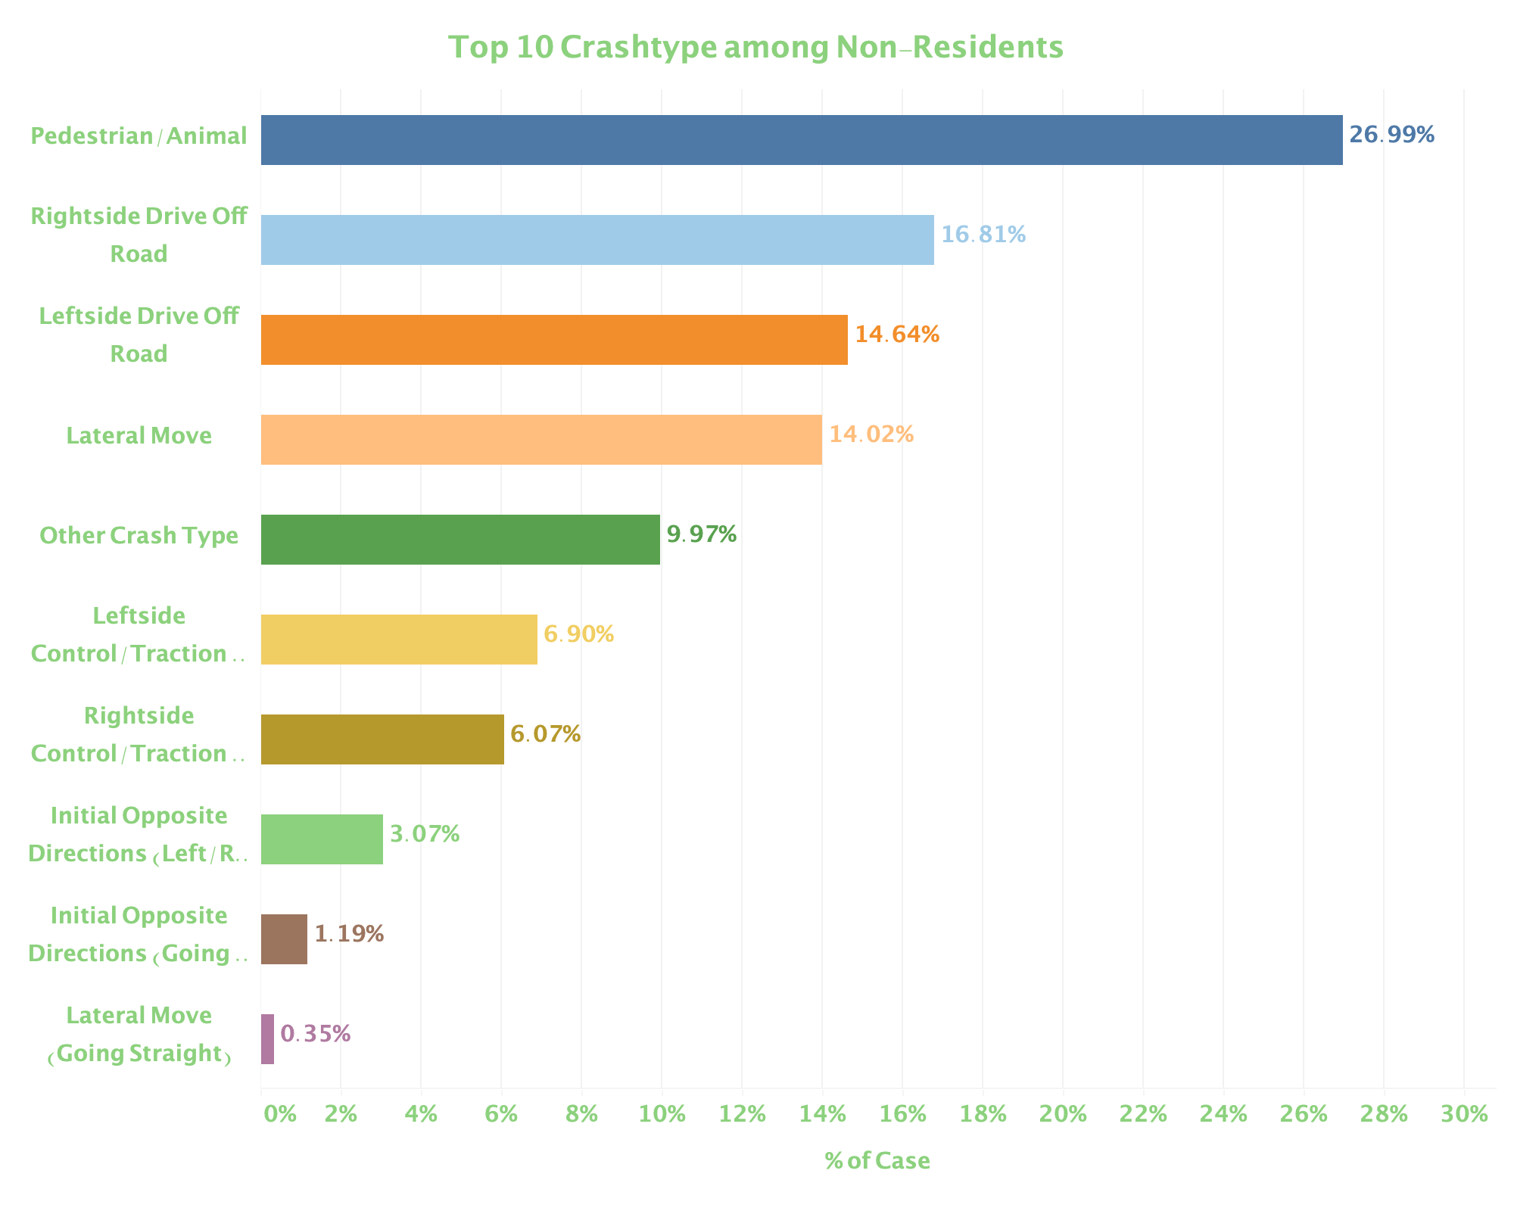
Resident VS. Non-resident
Notes:
Crash type

Slide 8
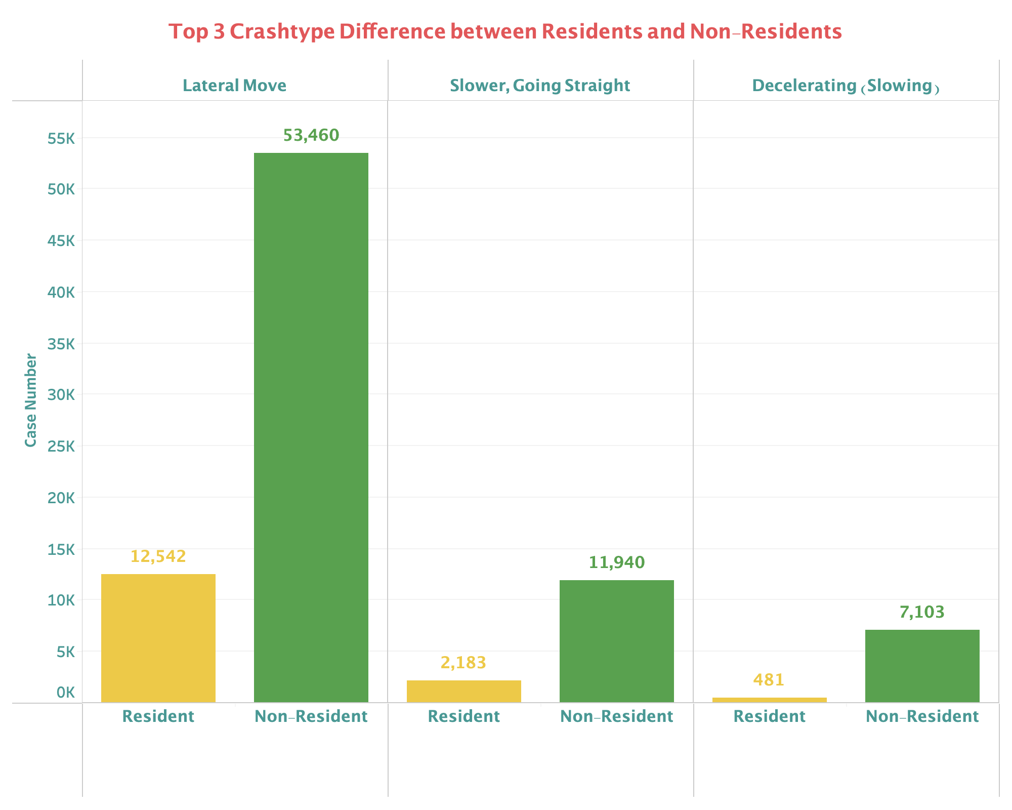
Resident VS. Non-resident
The chart shows the proportion of fatal accidents by crash categories, in resident and non-resident drivers separately.
The largest difference of case proportion appears in the crash types Lateral Move (Left/Right), Decelerating (Slowing), and Slower, Going Straight.
Notes:
Crash type

Slide 9
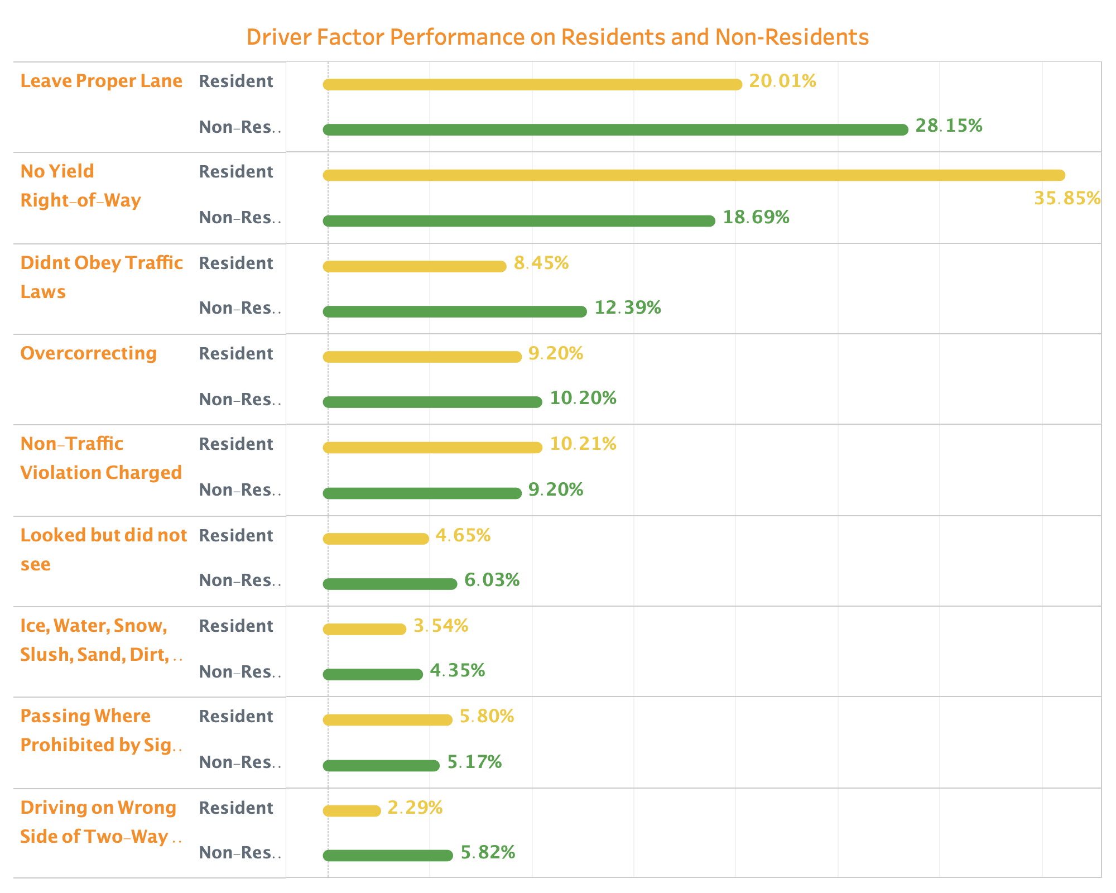
Resident VS. Non-resident
The chart shows the proportion of fatal accidents by behavior factors, in resident and non-resident drivers separately.
Compared to resident drivers, non-resident drivers are much more likely to encounter fatal accidents with leave proper lane.
Notes:
Behavior factor

Slide 10
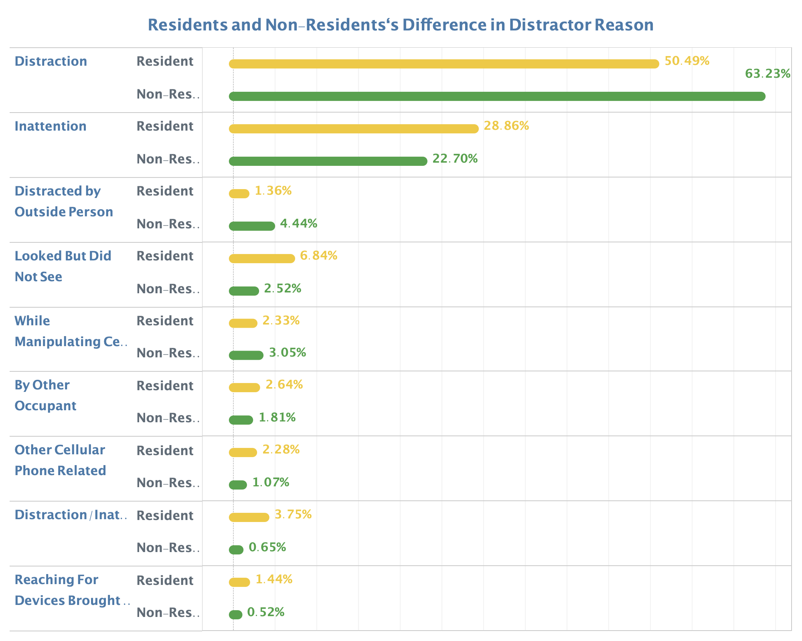
Resident VS. Non-resident
The chart shows the proportion of fatal accidents by distraction factors, in resident and non-resident drivers separately.
Compared to resident drivers, non-resident drivers in accidents are more likely to be involved with inattention, looked but did not see, distracted by outside person, talking or listening to phone, and eating or drinking.
Notes:
Behavior factor

Slide 11
Conclusion
Why non-resident drivers shows a much higher percentage in all fatal accidents?
Unfamiliar with local traffic can lead to frequent lateral move, deceleration and leaving improper lane. This could be the main reason of such high fatal accident percentage.
Distraction might be another reason for accidents with non-resident drivers.

Slide 12
Question
Is there any region that tend to produce higher-risk drivers that are involved in fatal crashes at a higher rate?
Notes:
(But how about dividing drivers by their address? Is there any region that tend to produce higher-risk drivers, that are involved in fatal accidents at a higher rate?)

Slide 13
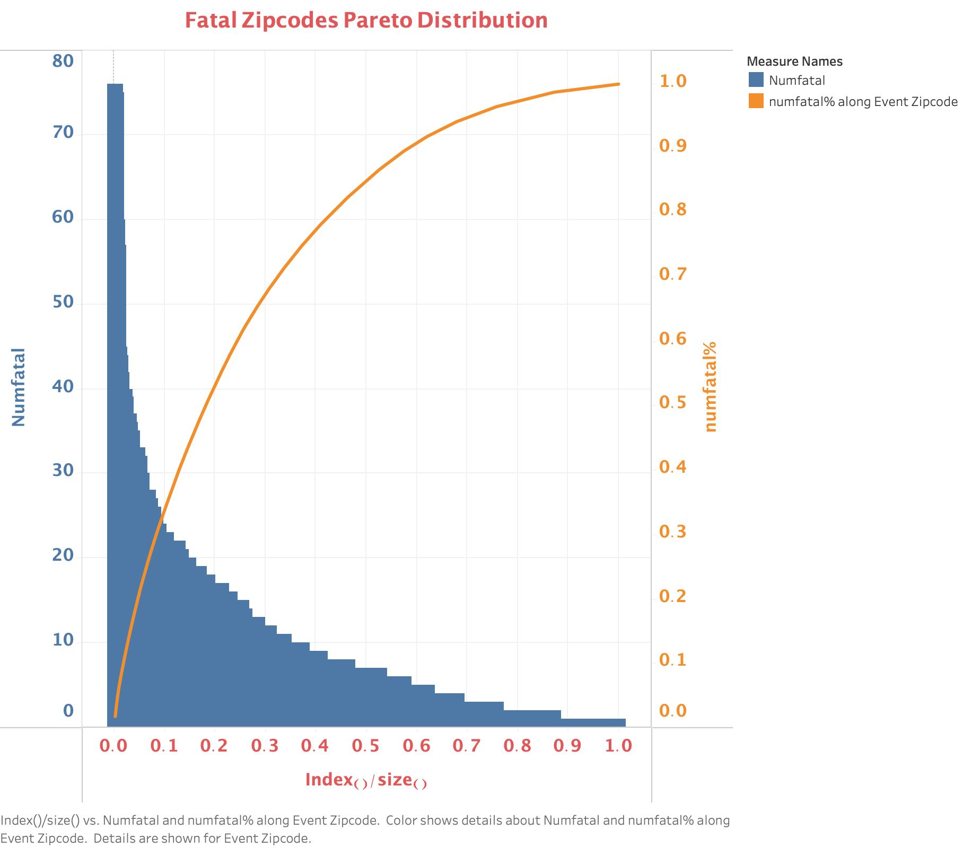
Region with high-risk Drivers?
The distribution of case proportion across zip codes is similar to Pareto distribution.
Few areas account for most of the risky drivers.
Notes:
Here is the plot of the address of drivers involved in fatal accidents by the zip code. From the chart we can see that the distribution of case proportion across zip codes is similar to Pareto distribution, the curve reaches 80% at 0.4, that is few areas account for most of the high-risk drivers.

Slide 14
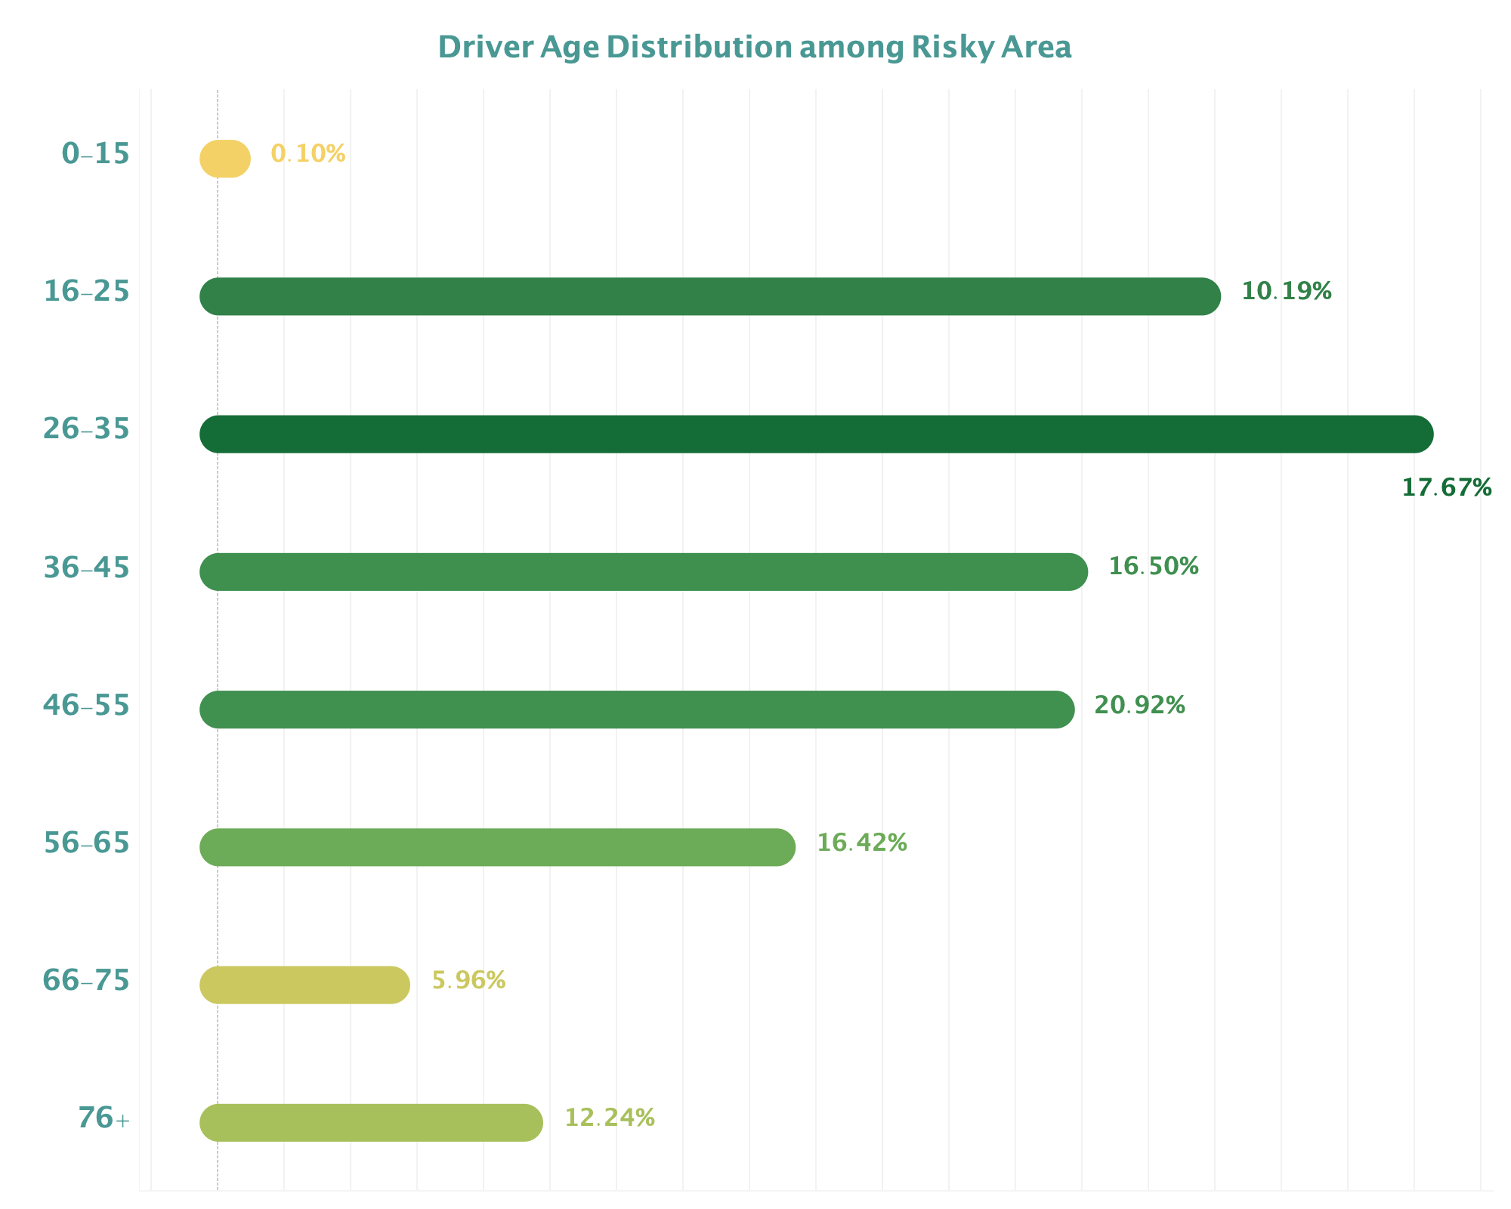
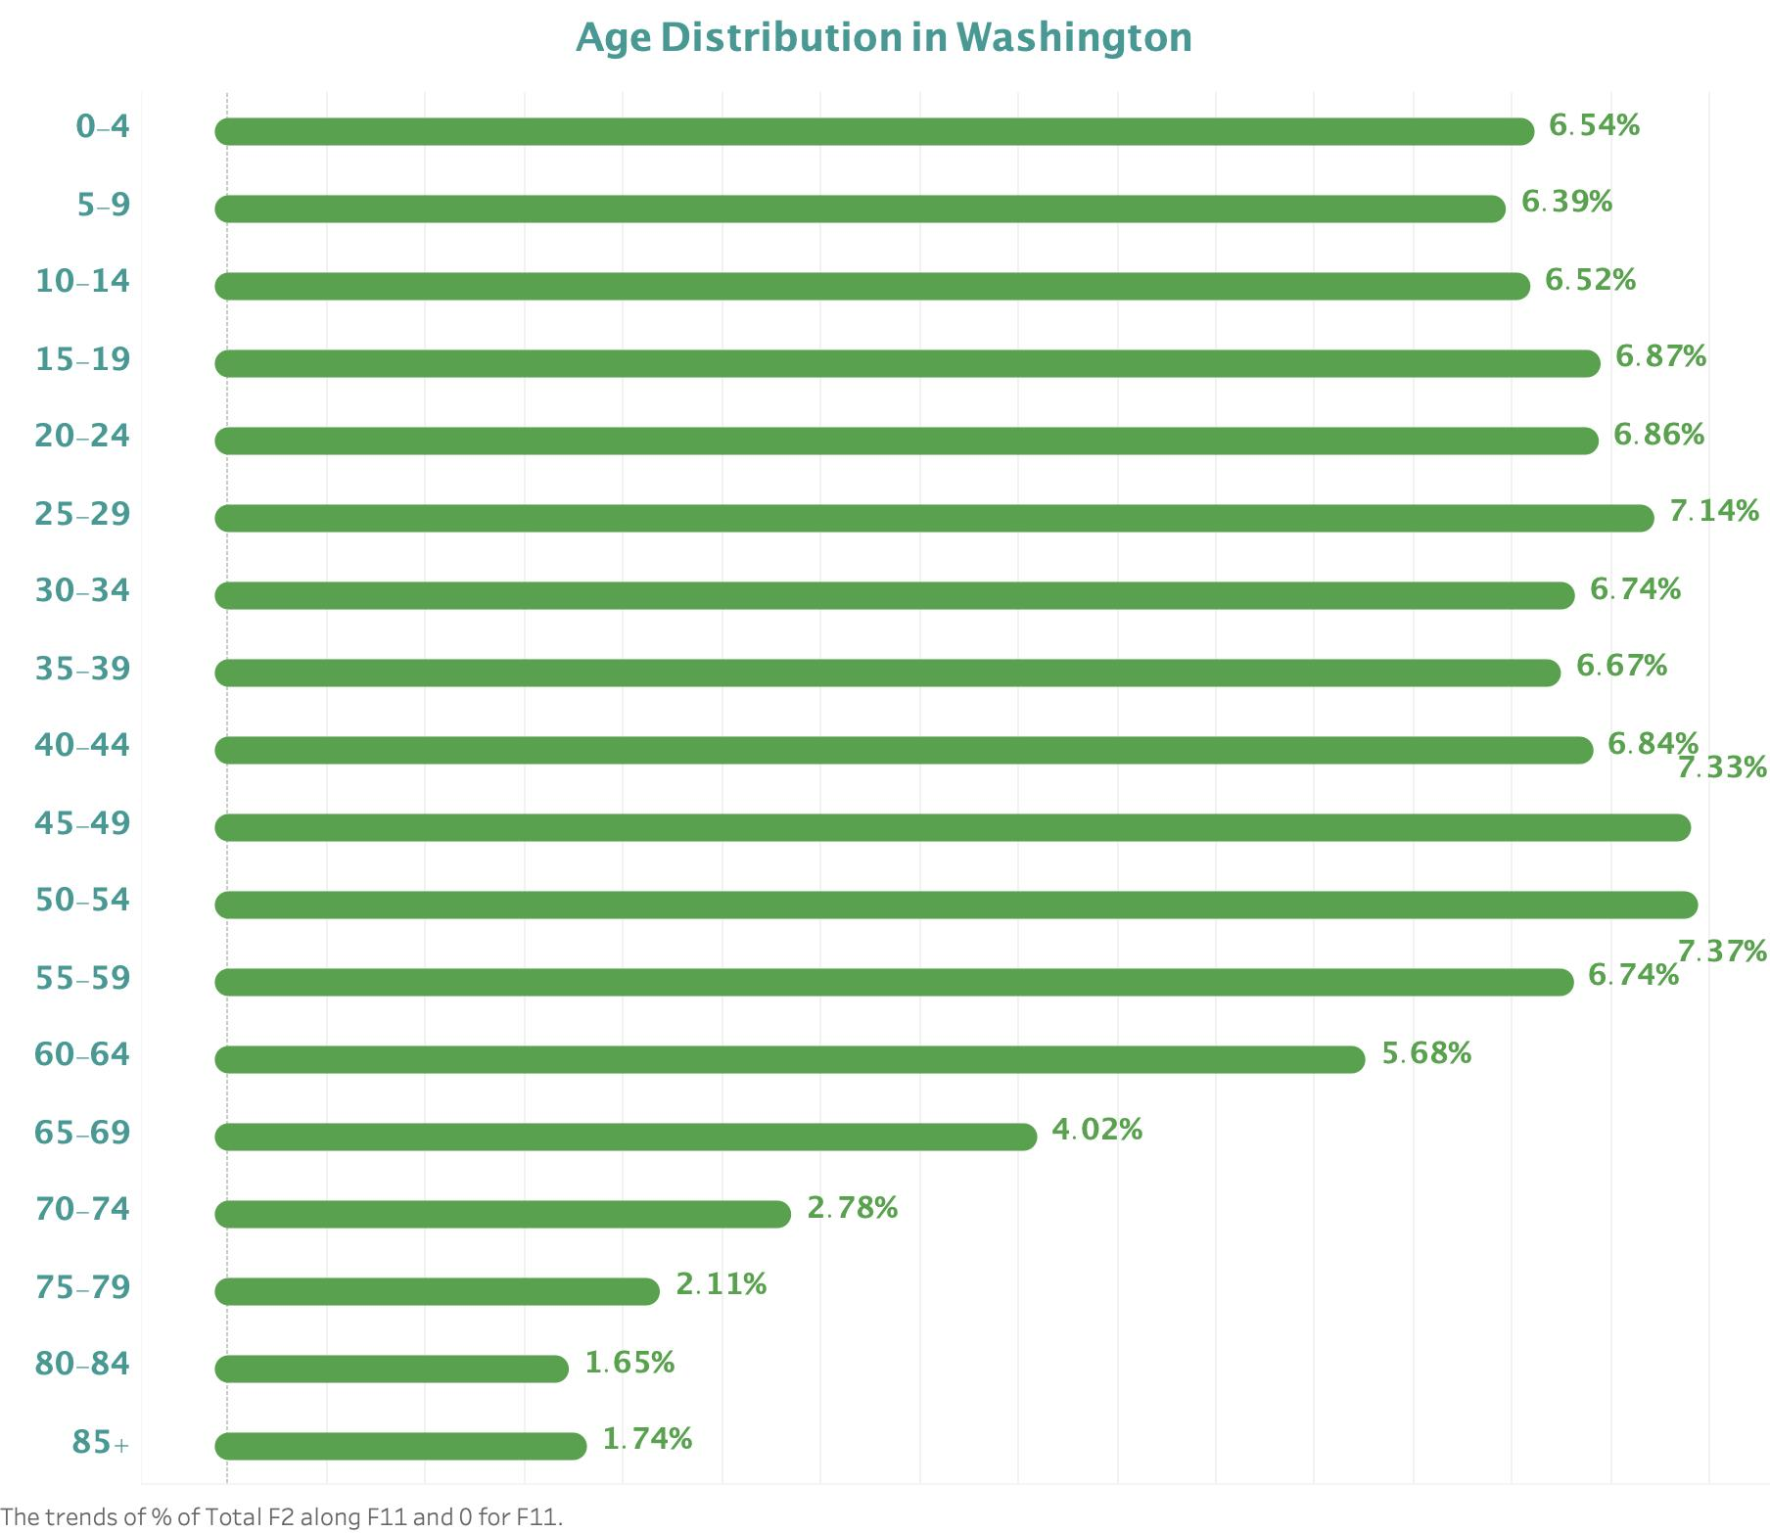
Drivers In High-risk Area
Washington Population^{[1]}
vs.
Notes:
Now, let’s analyze the population demographic of high-risk drivers. We compare it with the population of Washington state.
From the graphs above, we can see that age from 16 to 35 has a very high percentage. The reason might be young drivers are less skilled and are more likely to engage in dangerous driving behavior.
(I understood such reasons when the insurance company charged me for my car insurance. )

Slide 15
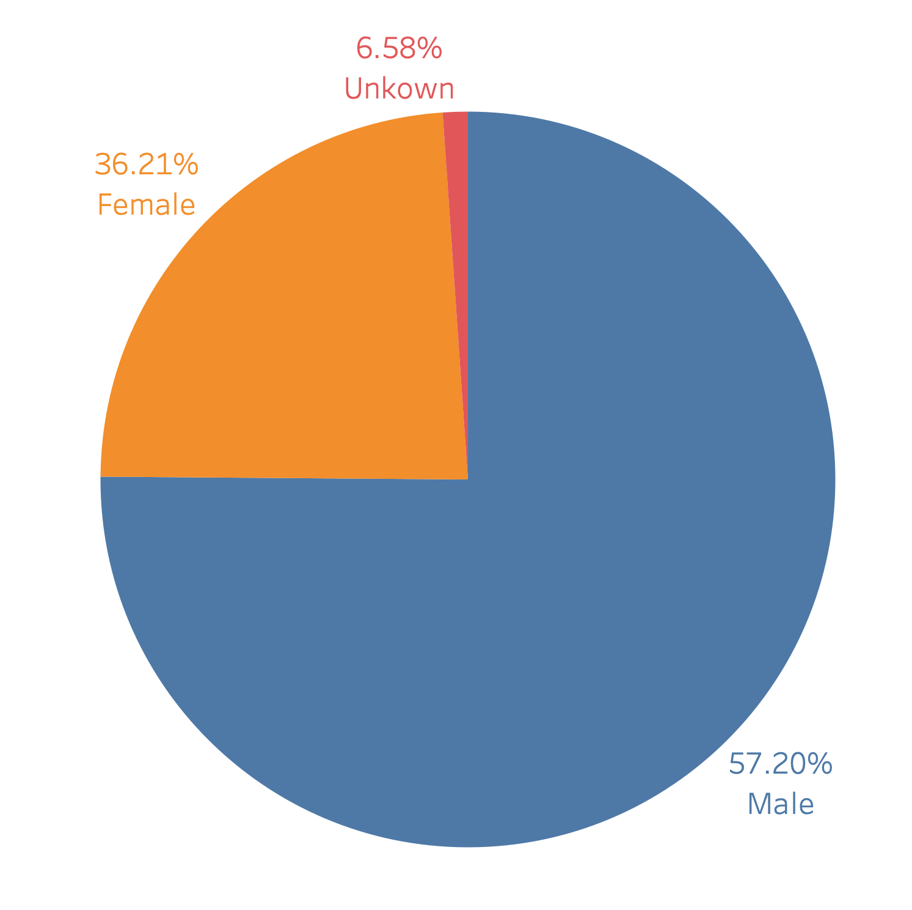
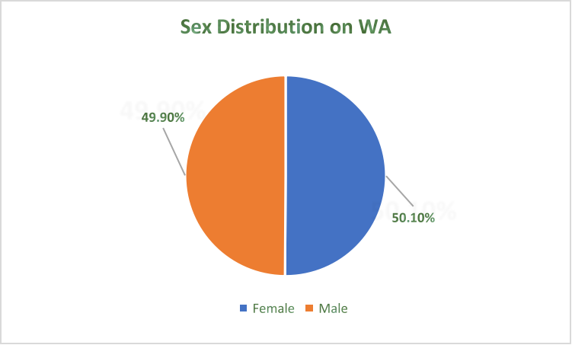
Drivers In High-risk Area
Washington Population^{[1]}
vs.
Notes:
There’re also more percentage male high-risk drivers involved in fatal accidents compared to female. The most possible reason is that more proportion of heavy transportation drivers are male, which can lead to very serious consequences if these vehicles are involved in accidents.

Slide 16
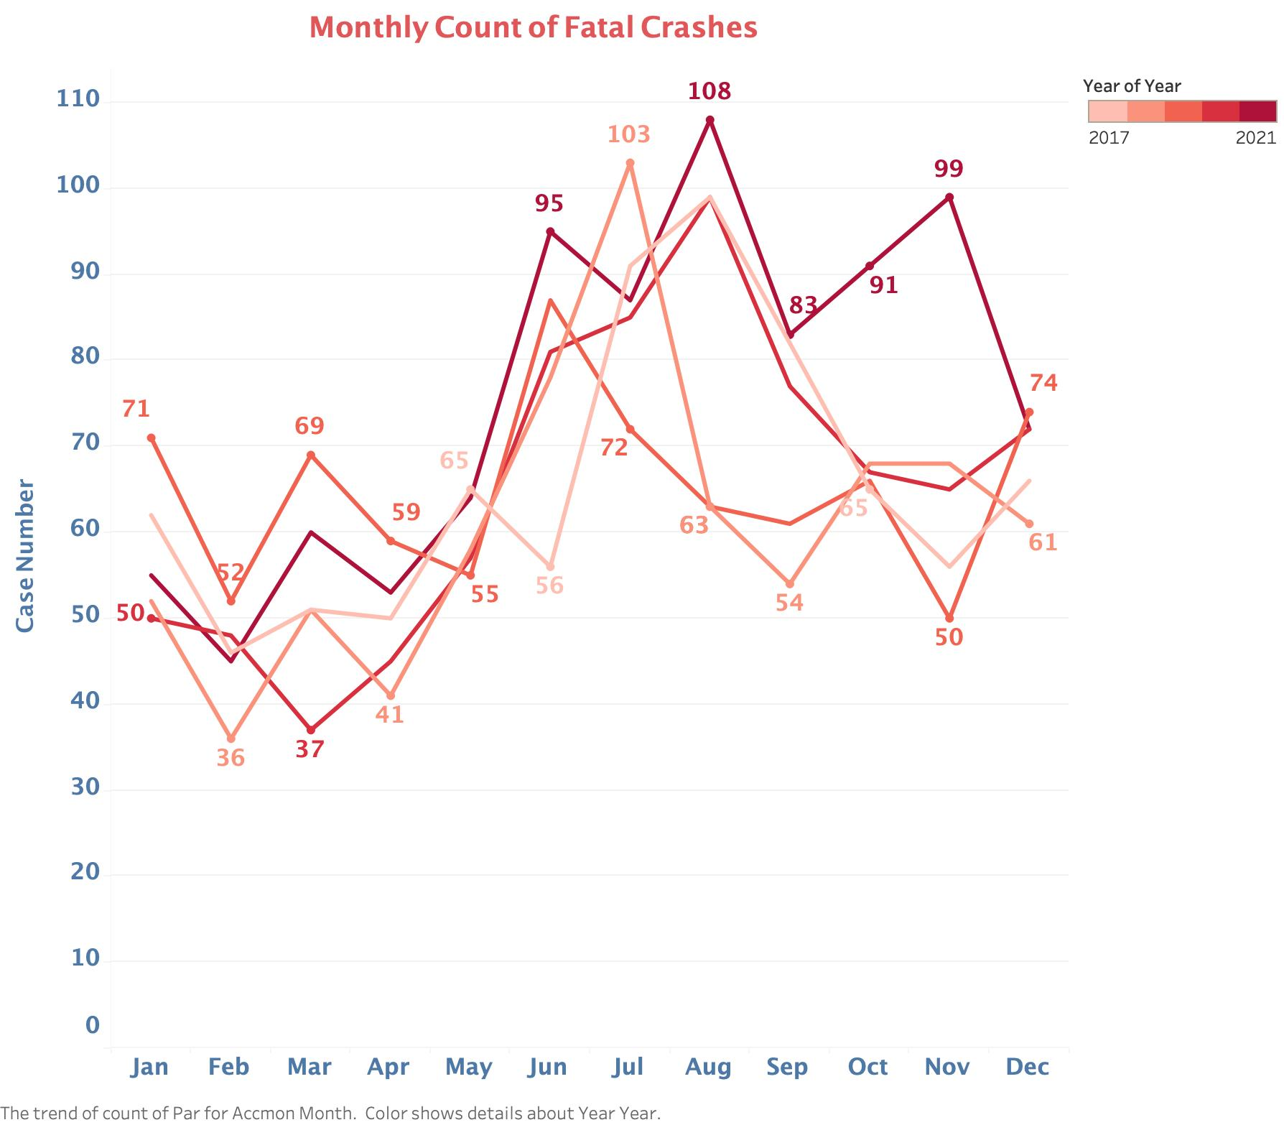
Seasonality
Seasonality in the number of fatal crashes throughout a year.
February appears to be the month with fewest number of crashes.
From 2017 through 2021, the monthly total of fatal crashes peak during July or August.
Notes:
Besides drivers and residents, we also analyzed data through out time.
This is the number of fatal accident in each month for each year. Strong seasonality can be found with winter the lowest and summer the highest.

Slide 17
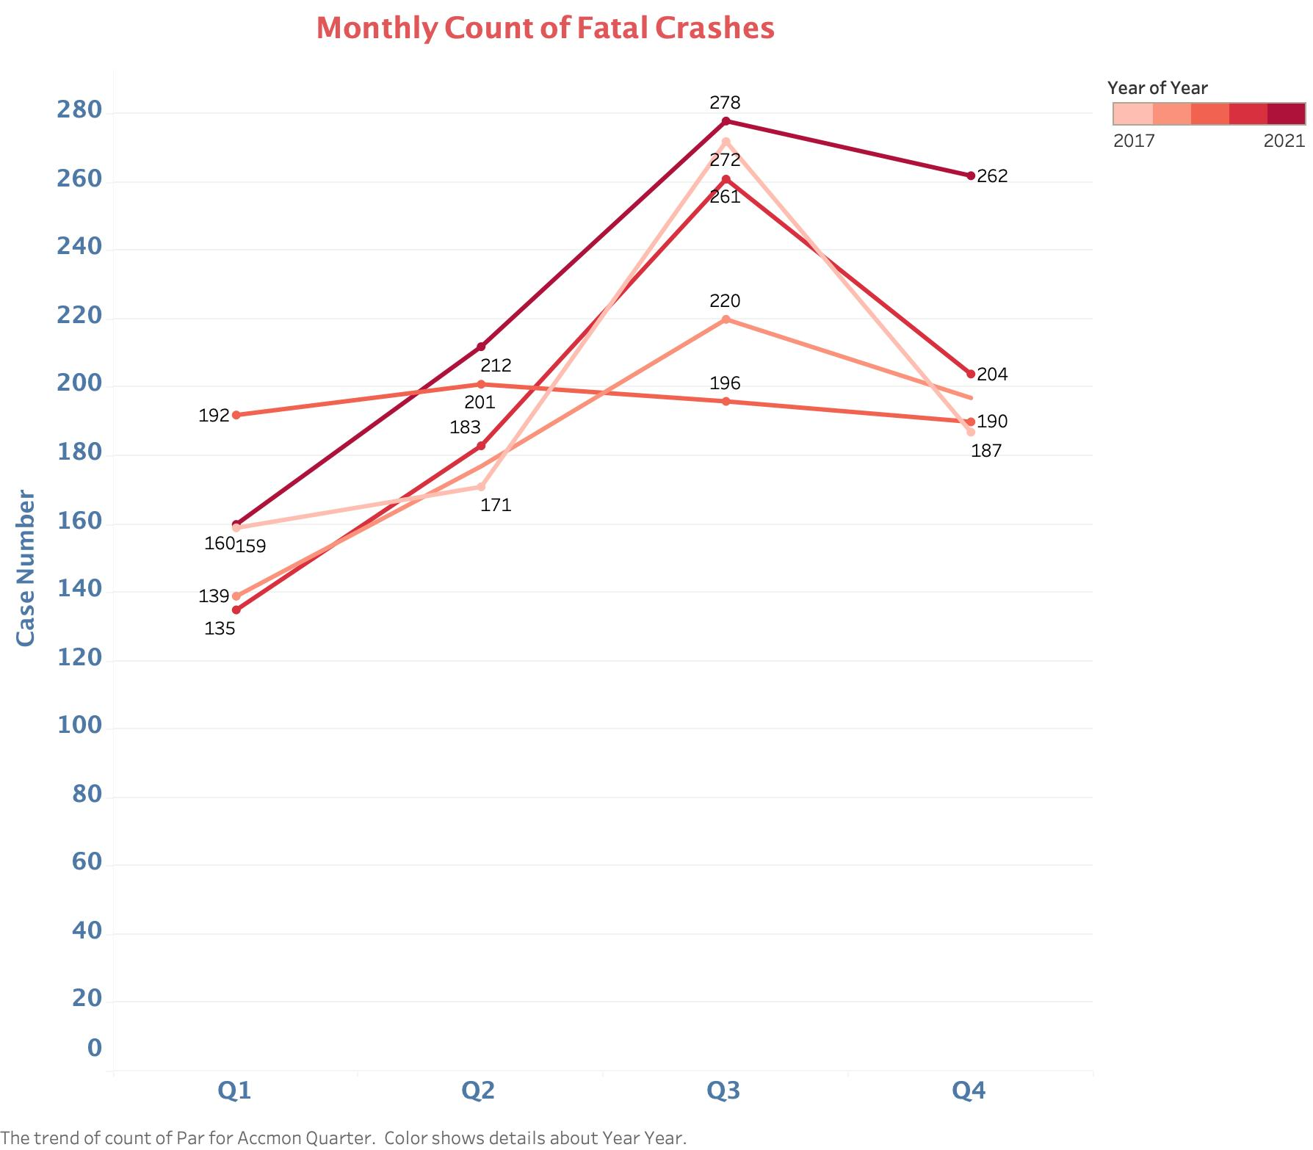
Conclusion
The number of monthly fatal accidents is related to temperature and precipitation. The higher the temperature, the more fatal accidents. The lower the precipitation, the more fatal accidents.
Increased outdoor activities due to fine weather from June to August may lead to more fatal accidents.
Notes:
(It also can be concluded from chart by each quarter.) We assume that the number of fatal accidents is related to temperature and precipitation. The higher the temperature, the more precipitation, the more fatal accidents. The possible reason is that fine weather leads to more outdoor activities, which cause accidents.

Slide 18
How to improve?
Predict potential accidents and warn drivers!
Notes:
With all the statistic data and conclusion above, I want to ask one more question: what we can do to improve such situation？Our solution is to predict potential accidents and warn the drivers.

Slide 19
Prediction
Models
Results
Random Forest, Decision Tree and Baseline
Accuracy: 61.2% F1 score: 0.522
Variables
Training and validation
Target: Crash Category
Independent: Location, Weather Condition, Light Condition, etc.
Scikit Learn Library
Notes:
This is the workflow of our prediction. (Since all the data is fatal accident,) we choose crash category as our target variable (instead of chance of accident. We choose Location, weather condition, light condition and some other variables as independent variables, which can be captured by sensors). We use scikit learn library as toolkit and tested the dataset on baseline, decision tree and random forest. Finally, we got 61.2% accuracy with a 0.522 F1 score on random forest.
Such prediction model can be used on cars to detect the surrounding environment and notify drivers. It can also be applied to traffic signs in high-risk areas to warn drivers passing by.

Slide 20
References
[1] Population Estimates | Office of Financial Management https://ofm.wa.gov/washington-data-research/population-demographics/population-estimates
[2] https://www.washington-demographics.com/zip_codes_by_population
[3] Teen Drivers and Passengers: Get the Facts https://www.cdc.gov/transportationsafety/teen_drivers/teendrivers_factsheet.html
[4] Addressing Gender Disparities in Transportation https://genderpolicyreport.umn.edu/addressing-gender-disparities-in-transportation/

Slide 21
Thanks!
Q&A

